Slide 1
The Local Ensemble Tangent Linear Model— a more perfect union of ensemble and 4DVAR methods
Sergey Frolov
In close collaboration with:
Doug Allen; Craig Bishop; Rolf Langland; Karl Hoppel; David Kuhl
and many others at NRL
ENKF workshop, Montreal, May 2018

Slide 2
Why we might want an ensemble-based TLM?
NWP index change data from UKMO
TLM is needed
H4DVAR
TLM-free method
TLM-Based Hybrids (H4DVAR) are currently better than TLM-Free Hybrid (H4DEnVAR)
H4DVAR
NWP index change (%)
H4DEnVAR
4DVAR
Ensemble size
old (LETKF)
ensemble
new (hybrid)
ensemble
Traditional TLMs are hard to maintain, are not projected to scale on the next generation computers, and are often not available for coupled models.
Can we secure benefits of TLM-based estimation while maintaining computational scalability and easy-of maintenance of ensemble-based systems?
Data adapted from Barker (2016)

Slide 3
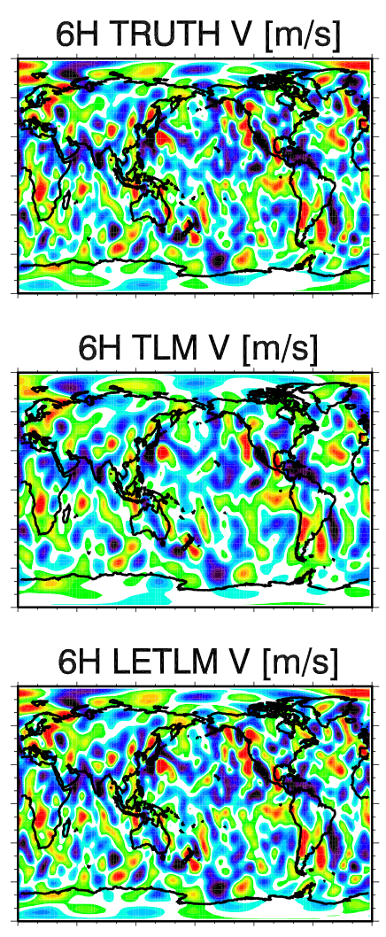
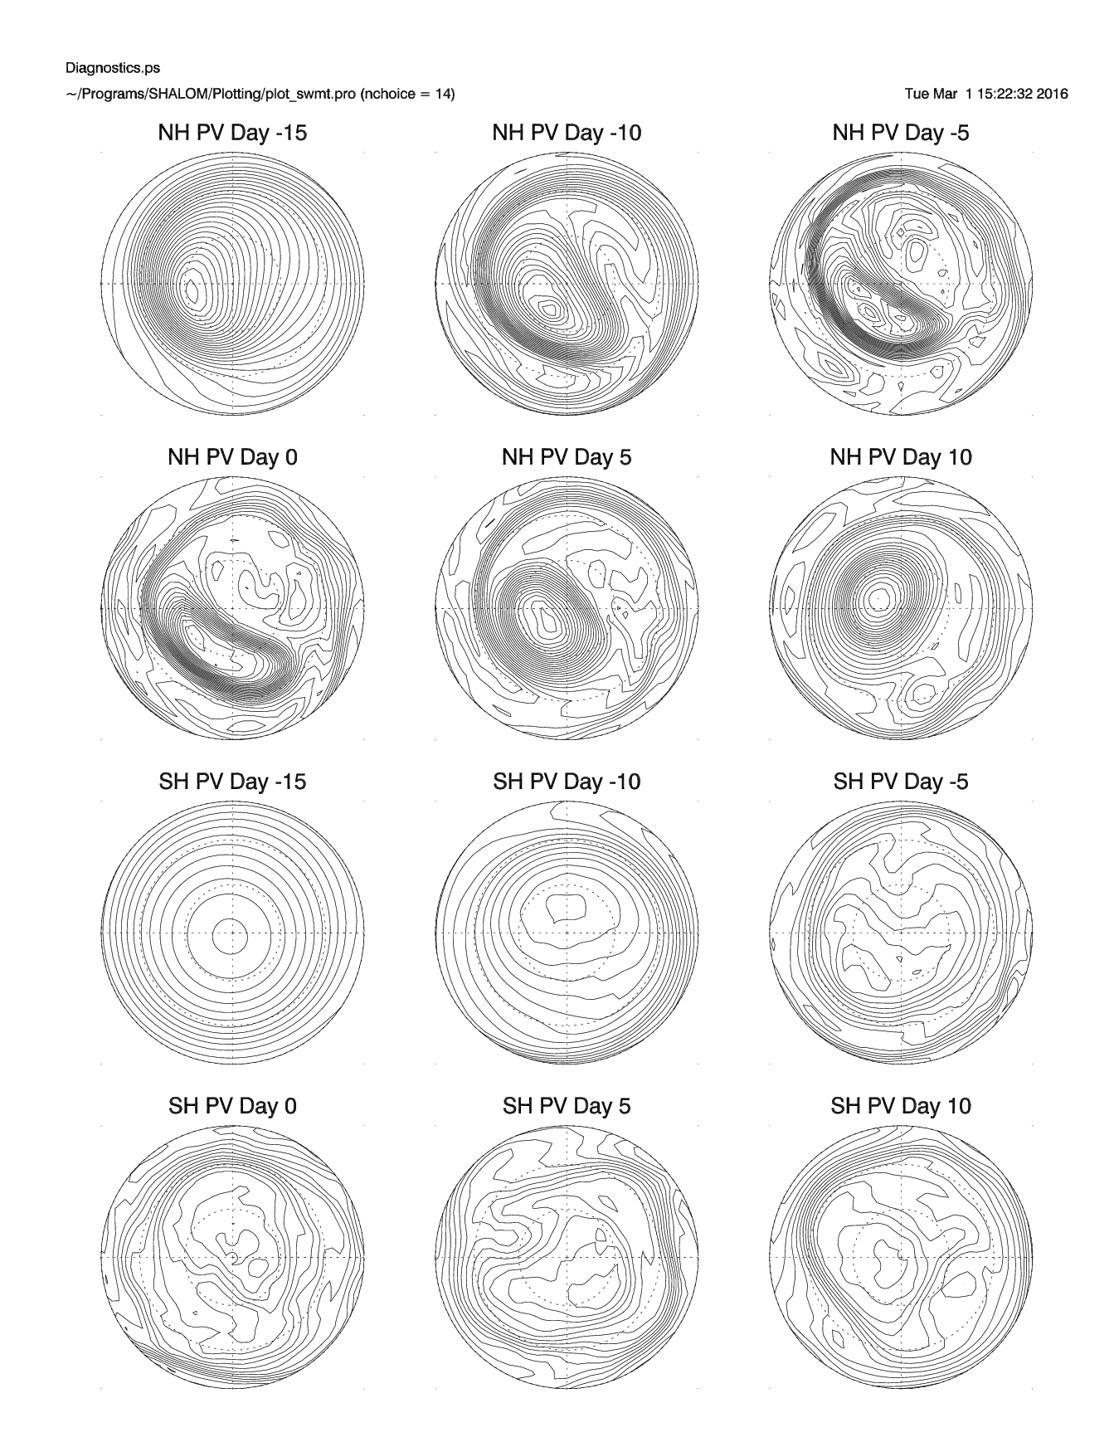
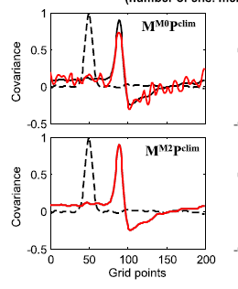
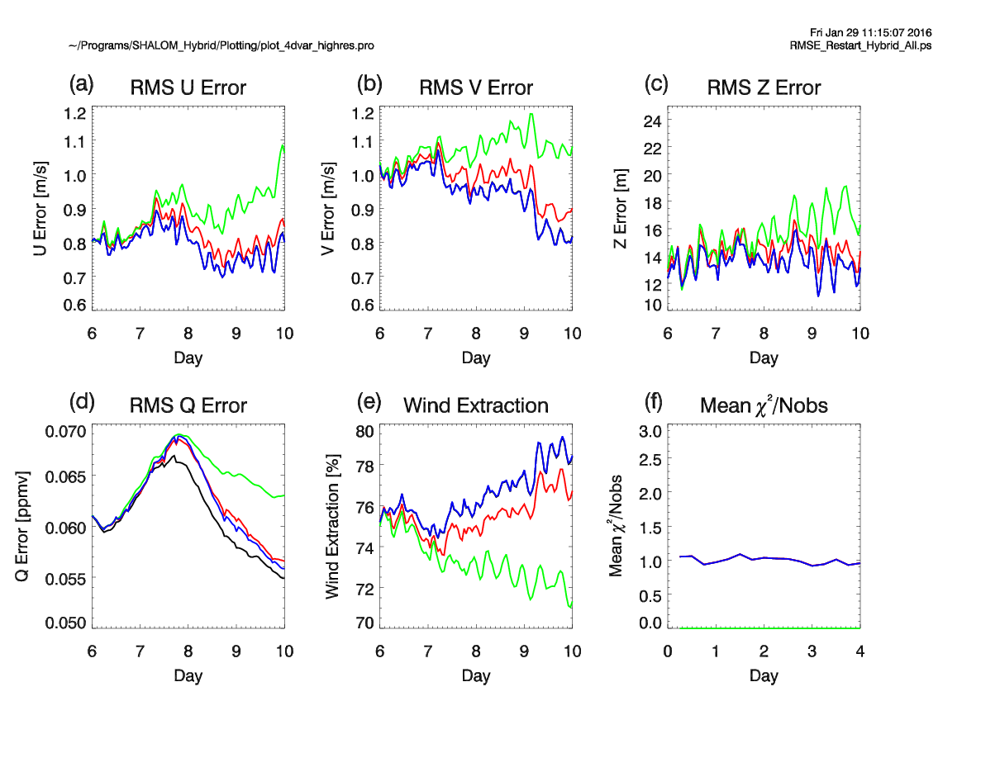
Progression of the LETLM work
2015
2016
2017
Next steps
Step to a higher resolution
Computational efficiency
Integration in H4DVAR
Idea conception
Demonstration with simple models
(Frolov and Bishop 2016, Bishop et.al. 2017)
First demonstration in a 4DVAR (for a shallow water model)
(Allan et.al. 2017)
First demonstration for an AGCM
(T47 NAVGEM)
(Frolov et.al. 2018)
This talk

Slide 4
LETLM formalism
Entire state x
for each points “i” build an ensemble regression model
forecast point
L
Defined at the prediction point at future time step
Defined for the influence volume at the previous time step
Influence volume
  Similar to finite difference models, LETLM updates each point based on the influence volume (stencil)
  Update is computed using an ensemble regression model for each point
Frolov etal (MWR 2016, 2018); Bishop et.al. (QJ 2017), Allan et.al. (MWR 2017)

Slide 5
LETLM formalism
Entire state x
for each points “i” build an ensemble regression model
forecast point
L
Defined at the prediction point at future time step
Defined for the influence volume at the previous time step
Influence volume
  Similar to finite difference models, LETLM updates each point based on the influence volume (stencil)
  Update is computed using an ensemble regression model for each point
  If number of ensemble members is greater than number of grid points in the stencil, the LETLM computation is exact.
Frolov etal (MWR 2016, 2018); Bishop et.al. (QJ 2017), Allan et.al. (MWR 2017)

Slide 6
LETLM formalism
Entire state x
for each points “i” build an ensemble regression model
forecast point
L
Defined at the prediction point at future time step
Defined for the influence volume at the previous time step
Influence volume
  Similar to finite difference models, LETLM updates each point based on the influence volume (stencil)
  Update is computed using an ensemble regression model for each point
  If number of ensemble members is similar to the DOF that predict future state x₁ the LETLM computation is accurate.
Frolov etal (MWR 2016, 2018); Bishop et.al. (QJ 2017), Allan et.al. (MWR 2017)

Slide 7
Low-res tests with a global AGCM
Forecast model (NAVGEM):
  Resolution T47L60: 2.5° and 60 levels.
  Full physics and radiation package.
Ensemble:
  Perturbations are drawn from an archive of 4DVAR corrections
  Disabled all stochastic processes in the ensemble forecast (GWD, SKEB, mass flux).
Test perturbation:
  4DVAR analysis increment
  Verified against a pair of non-linear forecasts
  Compared against a traditional TLM
  Final test on series of 7 different perturbations

Slide 8
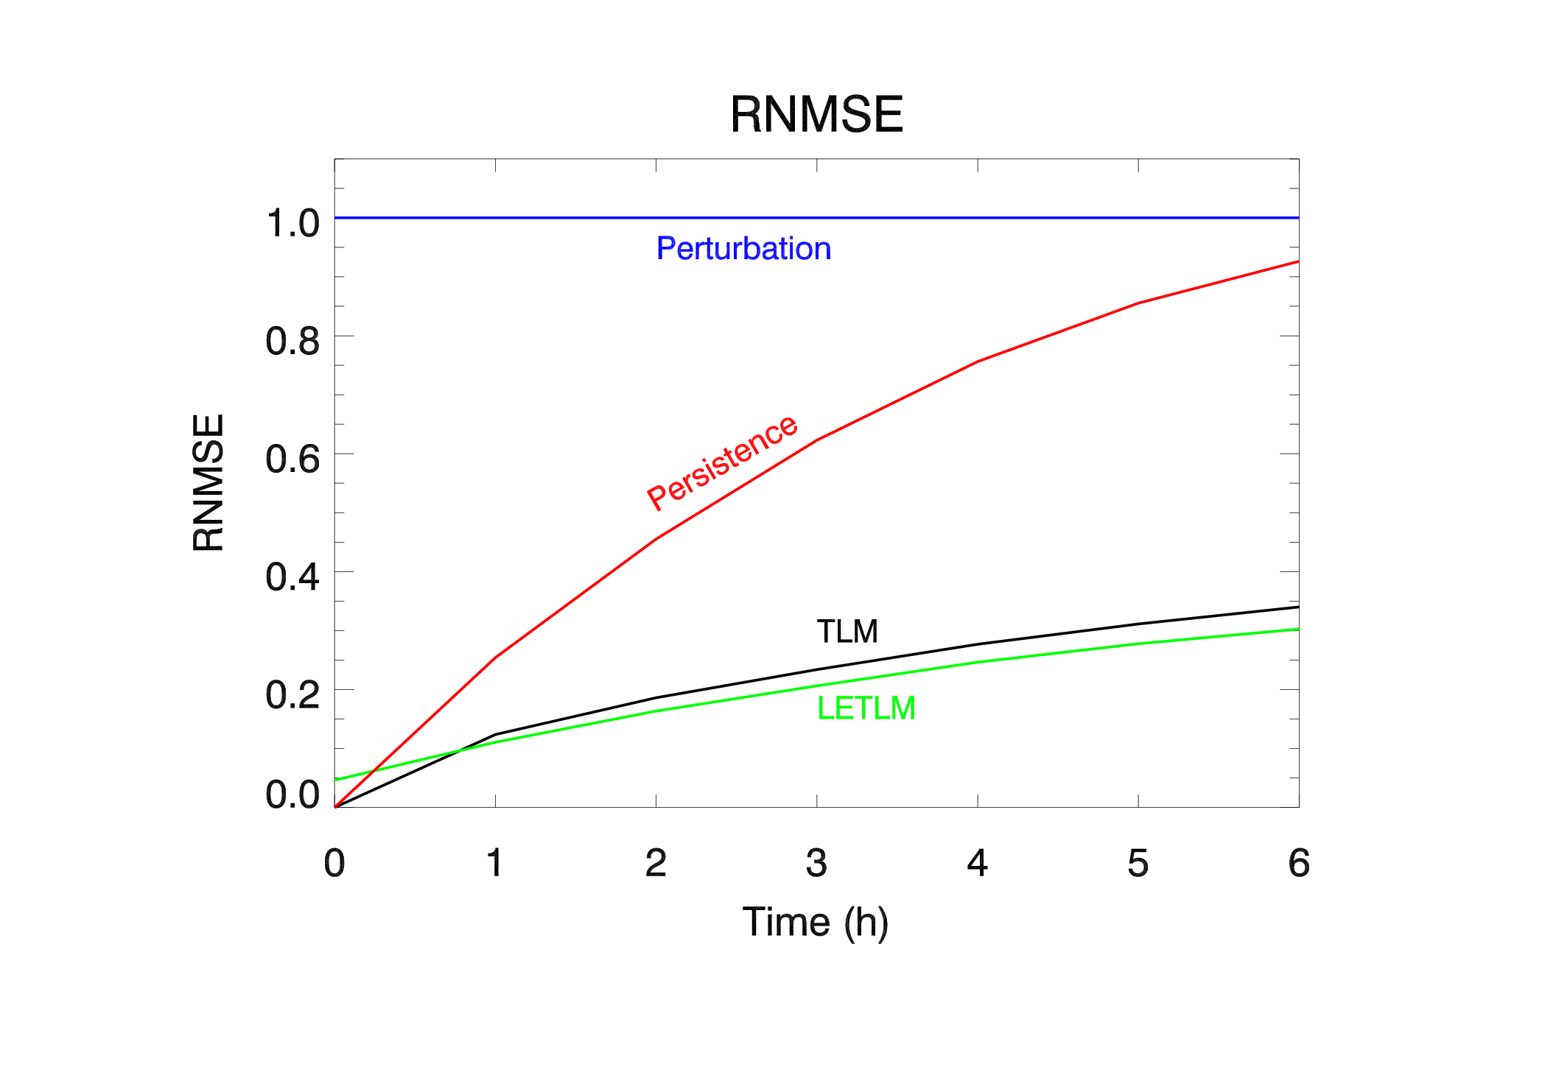
Performance in the nutshell
Both TLM and LETLM have skill over persistence.
LETLM forecast is better on average

Slide 9
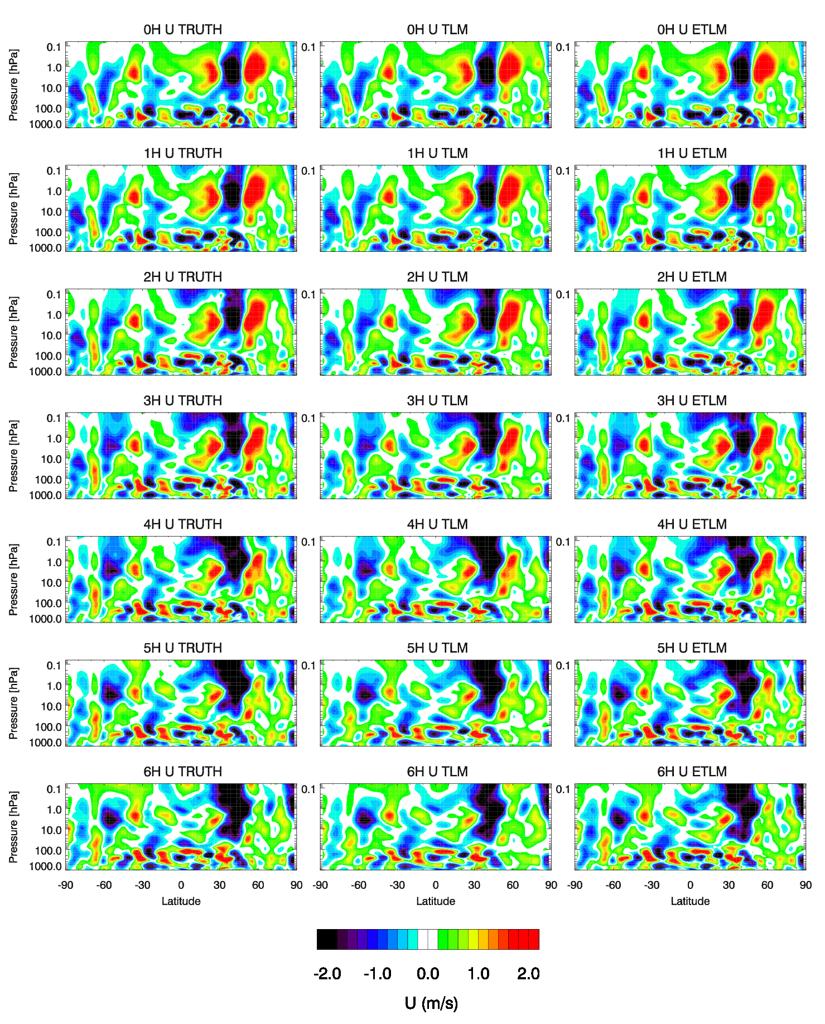
Evolution of the perturbation
truth
TLM
LETLM
0h
Both NOGAPS-TLM and LETLM have significant skill at evolving atmospheric features.
1h
2h
3h
4h
5h
6h

Slide 10
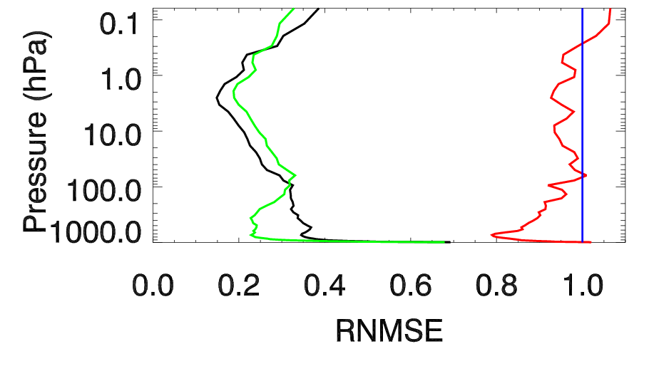
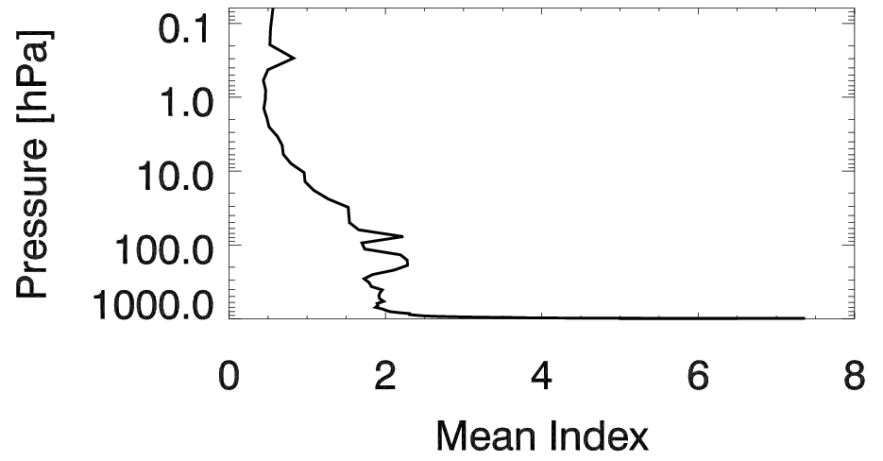
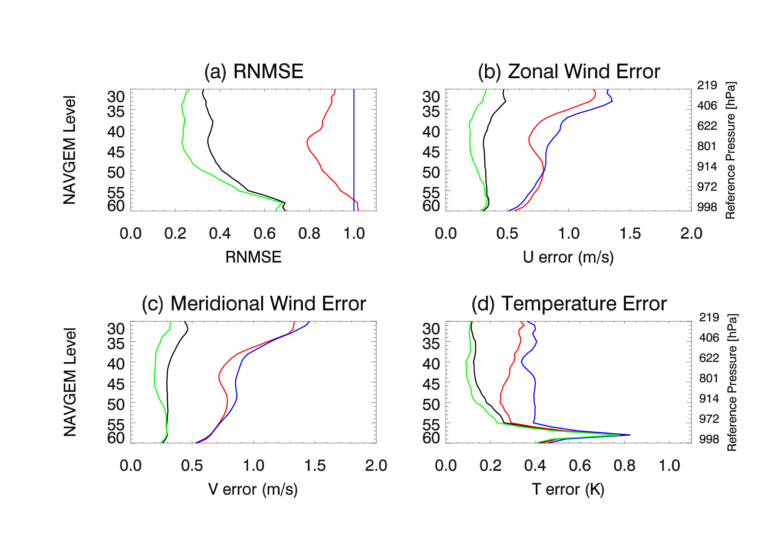
Average RMSE profiles for 6-h forecast
Average TLM error
Non-linearity index
TLM errors in troposphere
LETLM has superior performance in troposphere (more faithful representation of advection and physics?)
LETLM and NOGAPS TLM have similar (good) performance in the stratosphere
LETLM and NOGAPS TLM have similar (poor) performance in the PBL
LETLM is possibly best in mildly non-linear regimes (NLI 1-2).
TLM error
LETLM error
Persistence error (TLM=1)
Magnitude of the perturbation

Slide 11
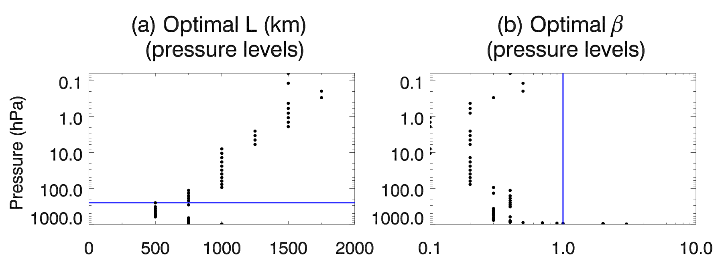
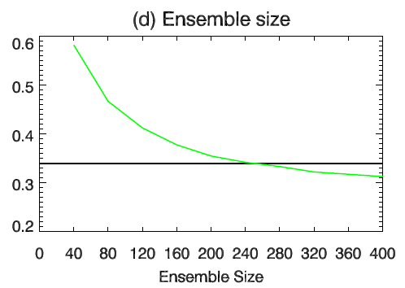
Sensitivity of the LETLM to tuning
NOGAPS TLM
LETLM sensitivity to number of ensembles
Horizontal halo increases with height to account for resolved gravity waves in the atmosphere.
Regularization parameter β increases in PBL to filter-out unresolved small-scale variability
LETLM is most sensitive to the number of ensemble members

Slide 12
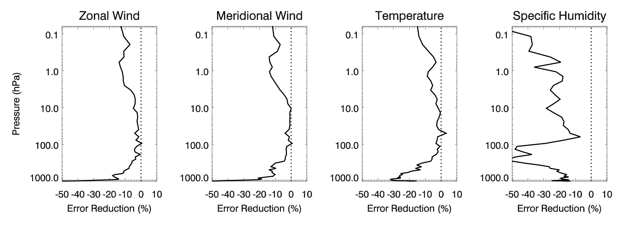
Sensitivity to presence of physics in the ensemble
Methods:
  Compute LETLM based on ensemble with and without physics package
Results:
  LETLM skill is considerably better with a physcis package turned on.
  Most sensitive in the lower troposphere (clouds and convection) and top of the atmosphere (radiation)

Slide 13
Computational profile
The LETLM cost:
  Is comparable to the cost of ensemble computation (~50-100 times more than a single semilagrangian forecast )
  10X speed-up for the LETLM computation is achievable
Most time is spend in LAPACK libraries, with almost no need for message passing
Key insight: LETLM can be pre-computed before DA runs

Slide 14
Next steps for the LETLM
Pre-compute TLM/ADJ
Before the critical path
Data assimilation
ADJ/Pb0/TLM
Ensemble and long forecast
5-h waiting for data to arrive
1-h critical path
IC for the model
6-h DA window
LETLM allows to move the bulk of the computations outside of the DA critical path
Lays the groundwork for assimilation in Earth system models (weather, ionosphere, ocean, waves, ice, …)

Slide 15
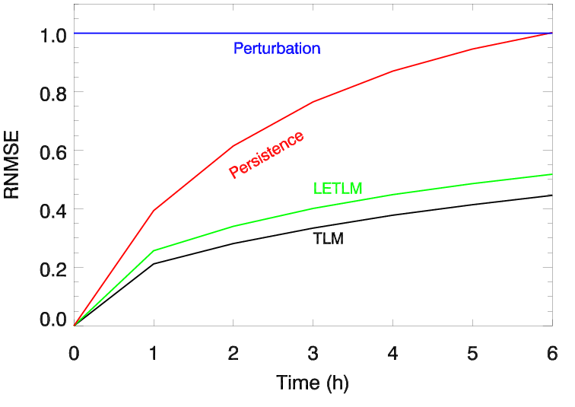
Hot off the press: experiments at a higher resolution
T47 results
Recent results with higher T119 resolution:
  400 members
  Shorter timestep (30 min) and shorter L where used.
  LETLM and TLM have comparable skill.
  More tuning is needed for T119 results.
New T119 results

Slide 16
End
Looking for post-docs to work on:
  Coupled data assimilation
  Ensemble forecasting
  And the LETLM

Slide 18
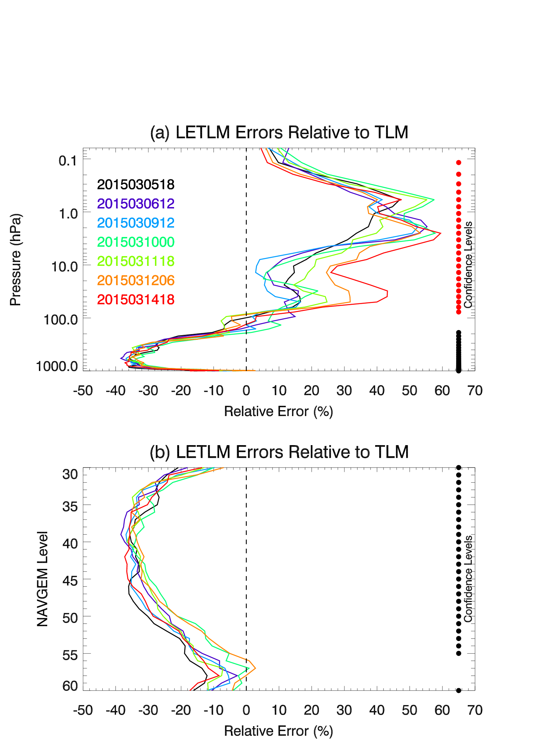
Comparison of seven test cases
Across seven test cases
  LETLM was better (than NOGAPS-TLM) in troposphere by an average of 30%
  LETLM was worse in stratosphere by an average of 25%
  LETLM was slightly better in the PBL (about 10%)

Slide 19
Strong scalability
TLM scalability
LETLM scalability
ideal
LETLM (24 openMP threads)
LETLM (12 openMP threads)
LETLM (6 openMP threads)
ideal
TLM
TLM scales up to 10 cores for T47 model
  Limited by global communication and few grid points (144 longitudes)
LETLM scales beyond 300 cores for T47 model
  Scales in x, y, and z
  Currently, limited by OpenMP startup costs for large CPU counts
  No parallel performance tuning have been attempted yet

